Slide 1

Abstractive Tweet Summarisation
Shubham Mondal
MT2022169

Slide 2
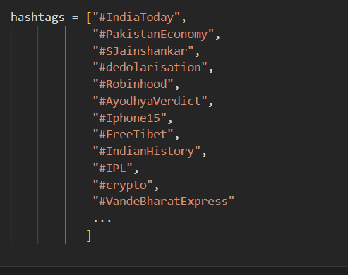
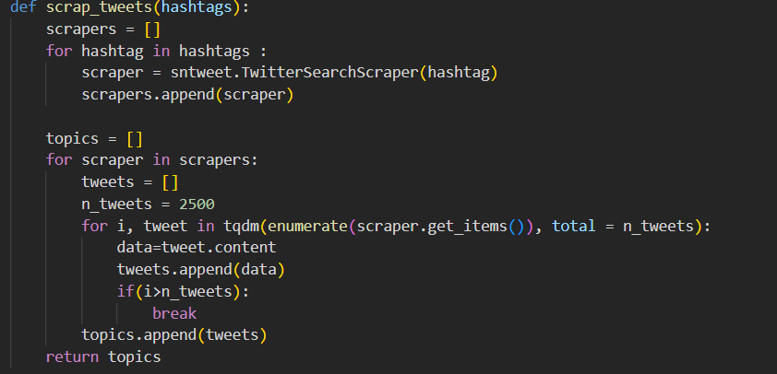
Data Extraction
- Used Snscrape to scrape twitter tweets of trending hashtags

Slide 3
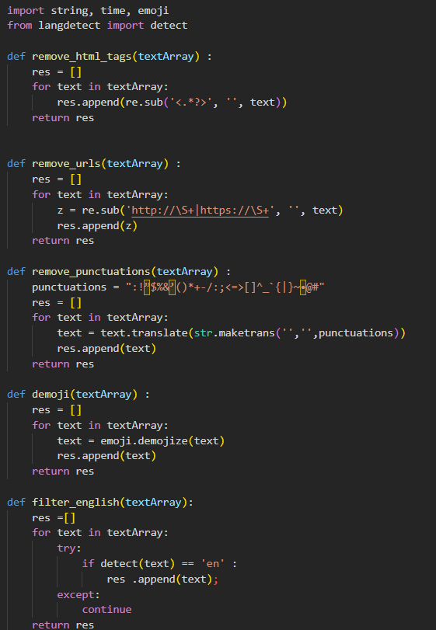
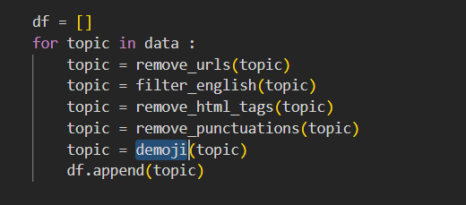
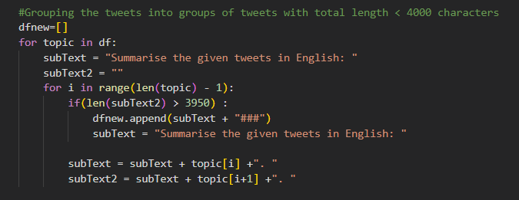
Pre-Processing
Basic Text pre-processing steps were applied on the data before generating summaries
The tweets were also grouped with token size of around 4000 characters and fed to chatgpt to generate summaries.

Slide 4
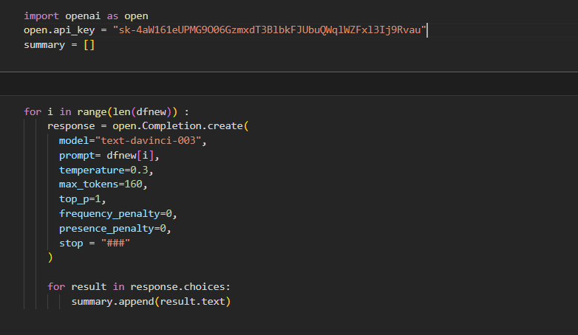
Corpus Generation
Chat-GPT API was used to generate all the summaries to train and finetune different models.
~1189 rows with grouped tweets and summaries were generated

Slide 5
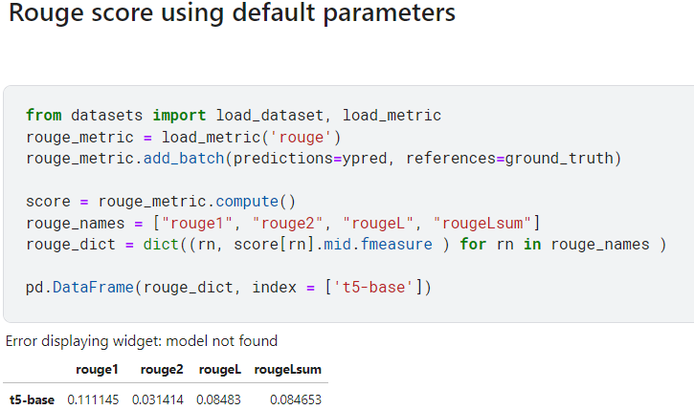
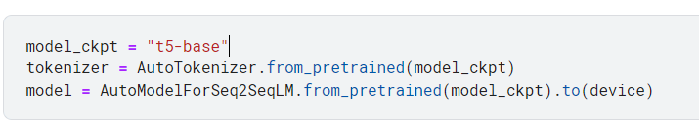
Using Pre-Trained Model T5-base
T5-base with pre-trained embeddings were used to generate summaries.
Rouge Score (rouge1) of ~0.12 was achieved.

Slide 6
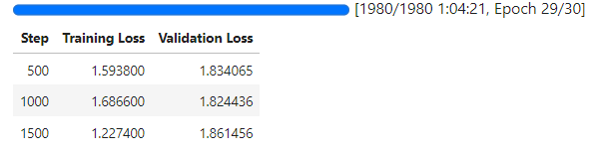
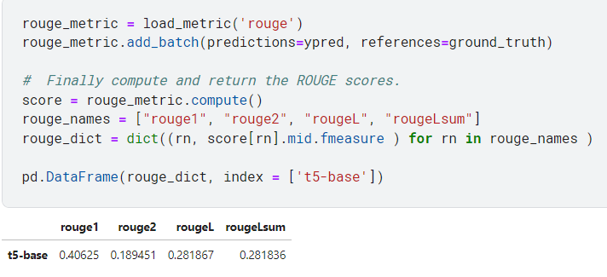
Model T5-base post Fine-tuning
T5-base post finetuning embeddings for 30 epochs.
Gave Rouge Score(rouge1) of ~0.40.

Slide 7
Summary Example
ChatGPTs Summary: India has gained a lot of goodwill around the world through its Vaccine Maitri diplomacy, which has helped India become known as the world's pharmacy. Indian Prime Minister Narendra Modi announced the Arogya Maitri Project, a global initiative to provide Covid-19 vaccines to countries in need. India has excelled in Disaster Diplomacy, VaccineMaitri, and huge operations for the evacuation of Indian citizens from crisis areas. India has donated 17,000 doses of vaccines to Nauru under the VaccineMaitri initiative, and has administered over 2.2 billion doses of Covid vaccine to its people and supplied it to over a 100 countries. India's VaccineMaitri is a model of India's global engagement.
FineTuned T5 Summary: In recent years, India has gained a lot of goodwill around the world through its Vaccine Maitri diplomacy, which helped India become known as the world's pharmacy. Indian Prime Minister Narendra Modi even announced the Arogya Maitri Project. India today is a vaccine and pharmaceutical powerhouse, having administered over 2.2 billion doses of Covid vaccine to its people and supplying it to over 100 countries.

Slide 8

References
Models - Hugging Face
Introduction to Text Summarization with ROUGE Scores | by Tan Pengshi
T5-base : Hugging face

Slide 9
Thank You

